Slide 1
Chapter 4 Nonverbal Communication Keimyung University
LEARNING OBJECTIVES
Nonverbal Communication - | Relational Contexts
 | Professional Contexts
 | Cultural Differences
 | Gender Differences*

Slide 2


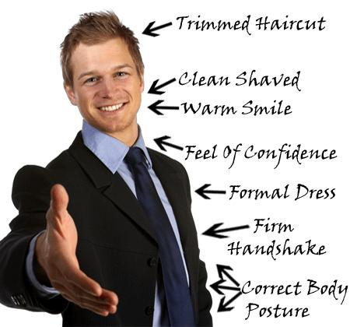



Chapter 4 Nonverbal Communication Keimyung University
Increases our expressivity
Relational Contexts

Slide 3
Chapter 4 Nonverbal Communication Keimyung University
Professional Contexts
Mixed Messages Professional Clip
Mixed Messages Non-Professional Fun Clip*
Mirroring (Rapport)

Slide 4

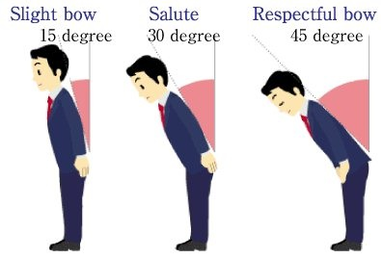
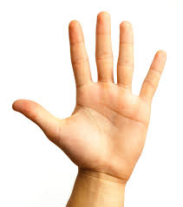
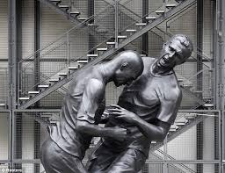
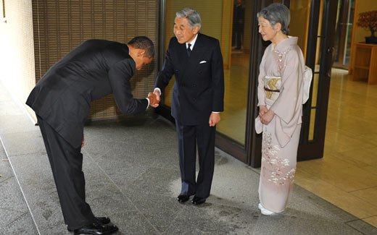
Chapter 4 Nonverbal Communication Keimyung University
Cultural Differences
Kinesics
Gestures
Cultural Gesture Quiz
Head Movements
Head But Clip
Eye Contact
Eye Clip
Haptics
Handshakes Clip

Slide 5
Chapter 4 Nonverbal Communication Keimyung University
Cultural Differences
Kinesics
Contact Culture
Italian Clip One
Italian Clip Two
Vocalics & Proxemics
For the Birds Clip
Chronemics
Monochronic and Polychronic Time Clip

Slide 6
Chapter 4 Nonverbal Communication Keimyung University
Gender Differences
Men and Women are 99% similar and 1% different
But, what are some differences?
Kinesics
Gestures
Women use more gestures than men, but men use larger gestures
Men use more physical adapters – foot and hand movements
because girls are socialized to avoid these – not ‘ladylike.’

Slide 7
Chapter 4 Nonverbal Communication Keimyung University
Gender Differences
Men and Women are 99% similar and 1% different
But, what are some differences?
Kinesics
Posture
Men are more likely to lean in rather than women
Women are more lilely to have a face-to-face body orientation
Eye Contact
Women use more eye-contact
Women do more looking and get looked at more than men

Slide 8
Chapter 4 Nonverbal Communication Keimyung University
Gender Differences
Men and Women are 99% similar and 1% different
But, what are some differences?
Kinesics
Facial Expressions
Women reveal emotion through facial expression more
frequently and more accurately than men
Men are more likely to show angry facial expressions
Women smile more than men…girls are rewarded when showing emotions, men are rewarded when they conceal emotions

Slide 9

Chapter 4 Nonverbal Communication Keimyung University
Gender Differences
Men and Women are 99% similar and 1% different
But, what are some differences?
Haptics
Do men touch women more than women touch men?
Women touch women more than men touch men
In general men read more sexual intent into touch than women do. Women often underinterpret sexual intent.
Touch Taboos?

Slide 10
Chapter 4 Nonverbal Communication Keimyung University
Gender Differences
Men and Women are 99% similar and 1% different
But, what are some differences?
Vocalics
Women use more vocal variety - adds to the sterotype that women are more expressive than men
Women usually end sentences with a higher pitch…which implies a lack of certainty, even when there isn’t.

Slide 11
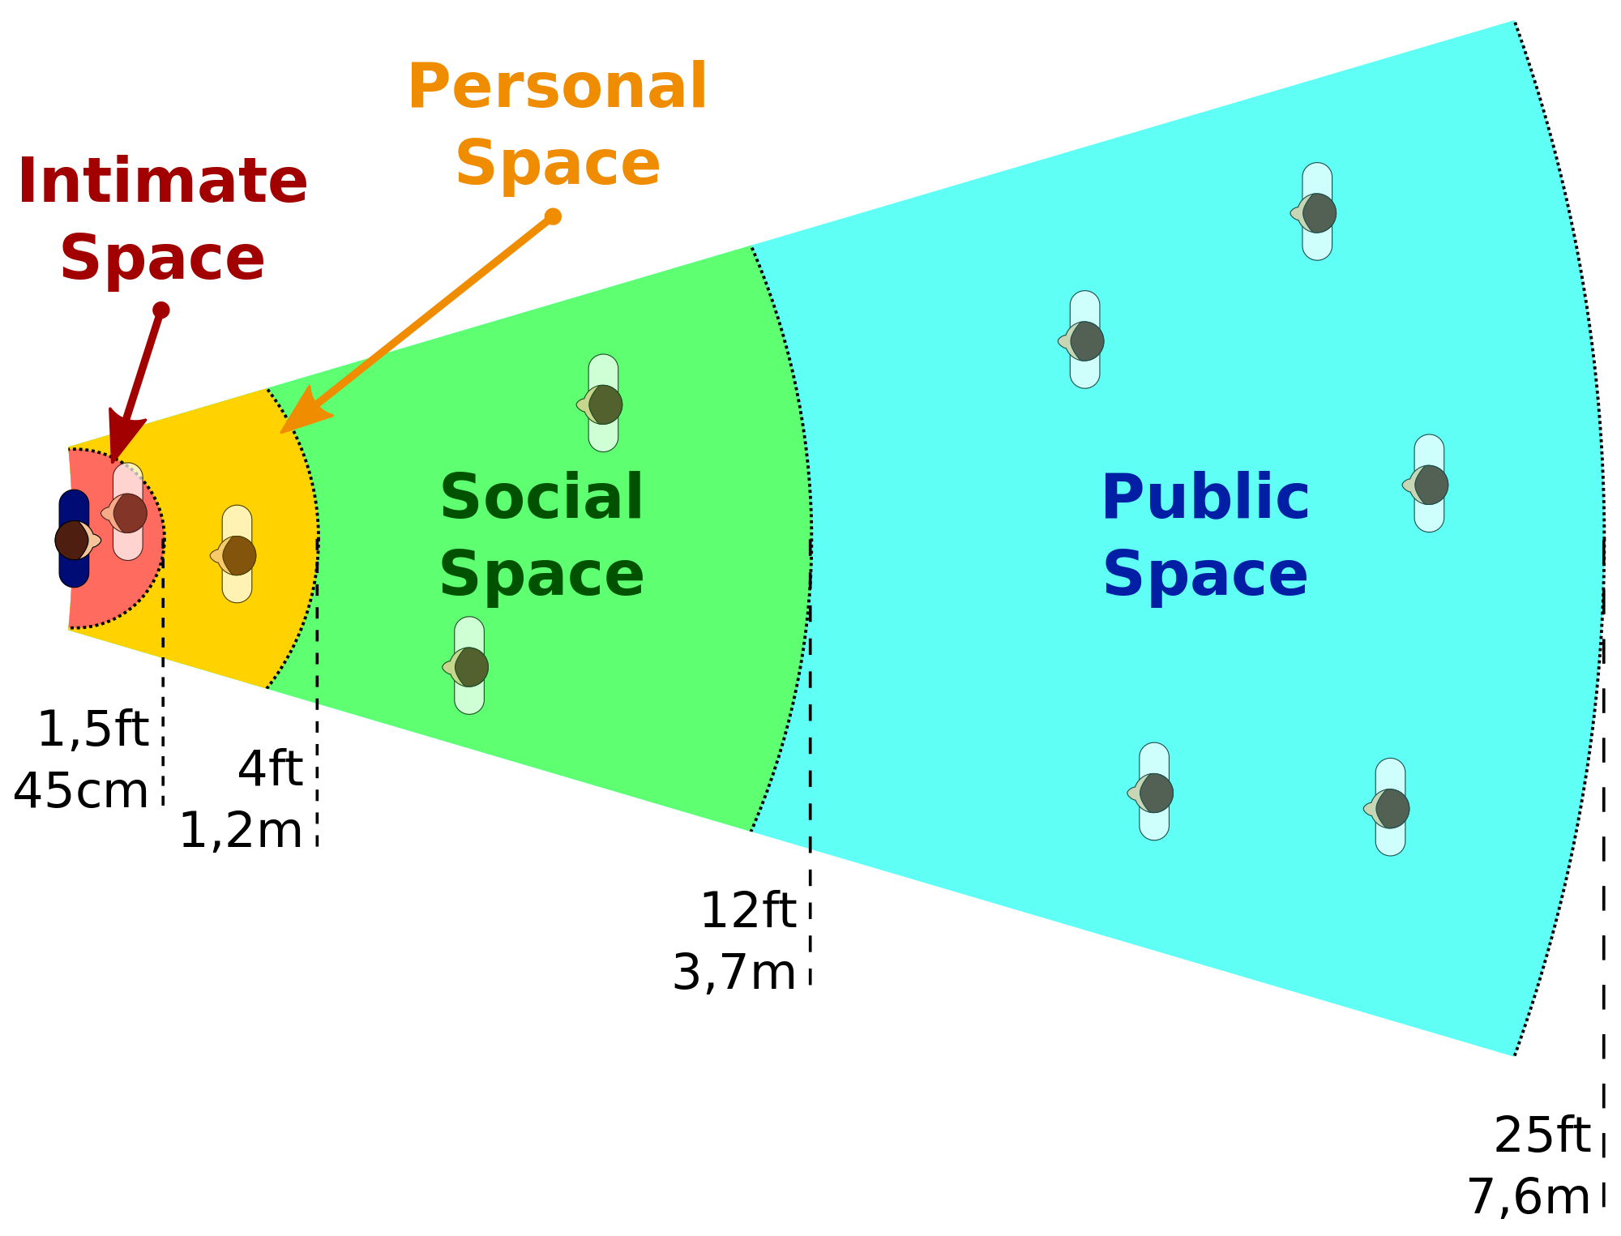
Chapter 4 Nonverbal Communication Keimyung University
Gender Differences
Men and Women are 99% similar and 1% different
But, what are some differences?
Proxemics
Men are implicitly socialized to take up as much space as possible, women are explicilty socialized to take up less space.
Women interact closer to other women, than men do to men in terms of interpersonal distance.
Men do not respond as well as women in situations involving crowding…high-density environments evoke negative feelings from men…which can lead to physical violence in a very crowded setting.

Slide 12
Chapter 4 Nonverbal Communication Keimyung University
Gender Differences
Men and Women are 99% similar and 1% different
But, what are some differences?
Self-Presentation
Women accentuate their physical attractiveness and men accentuate their status and wealth.
Women and men both accentuate their biological differences.
- Curve-fitting clothes
- Shoulder Pads
- Shaving legs
- Manscaping

Slide 13
Chapter 4 Nonverbal Communication Keimyung University
Key Takeaways
1 | A central function of nonverbal communication is the establishment and maintenance of interpersonal relationships.
2 | Professionals indicate that nonverbal communication is an important part of their jobs. Organizational leaders can use nonverbal decoding skills to tell when employees are under stress and in need of support and can then use encoding skills to exhibit nonverbal sensitivity. Nonverbal signals can aid in impression management in professional settings, such as in encoding an appropriate amount of enthusiasm and professionalism.
3 | Although some of our nonverbal signals appear to be more innate and culturally universal, many others vary considerably among cultures, especially in terms of the use of space (proxemics), eye contact (oculesics), and touch (haptics).
4 | In terms of gender, research has consistently found, however, that women gesture, make eye contact, touch and stand close to same-gender conversational partners, and use positive facial expressions more than men.

